Slide 1




Tech Gurus
Guru is Aspiration, Guru is Inspiration!

Slide 2
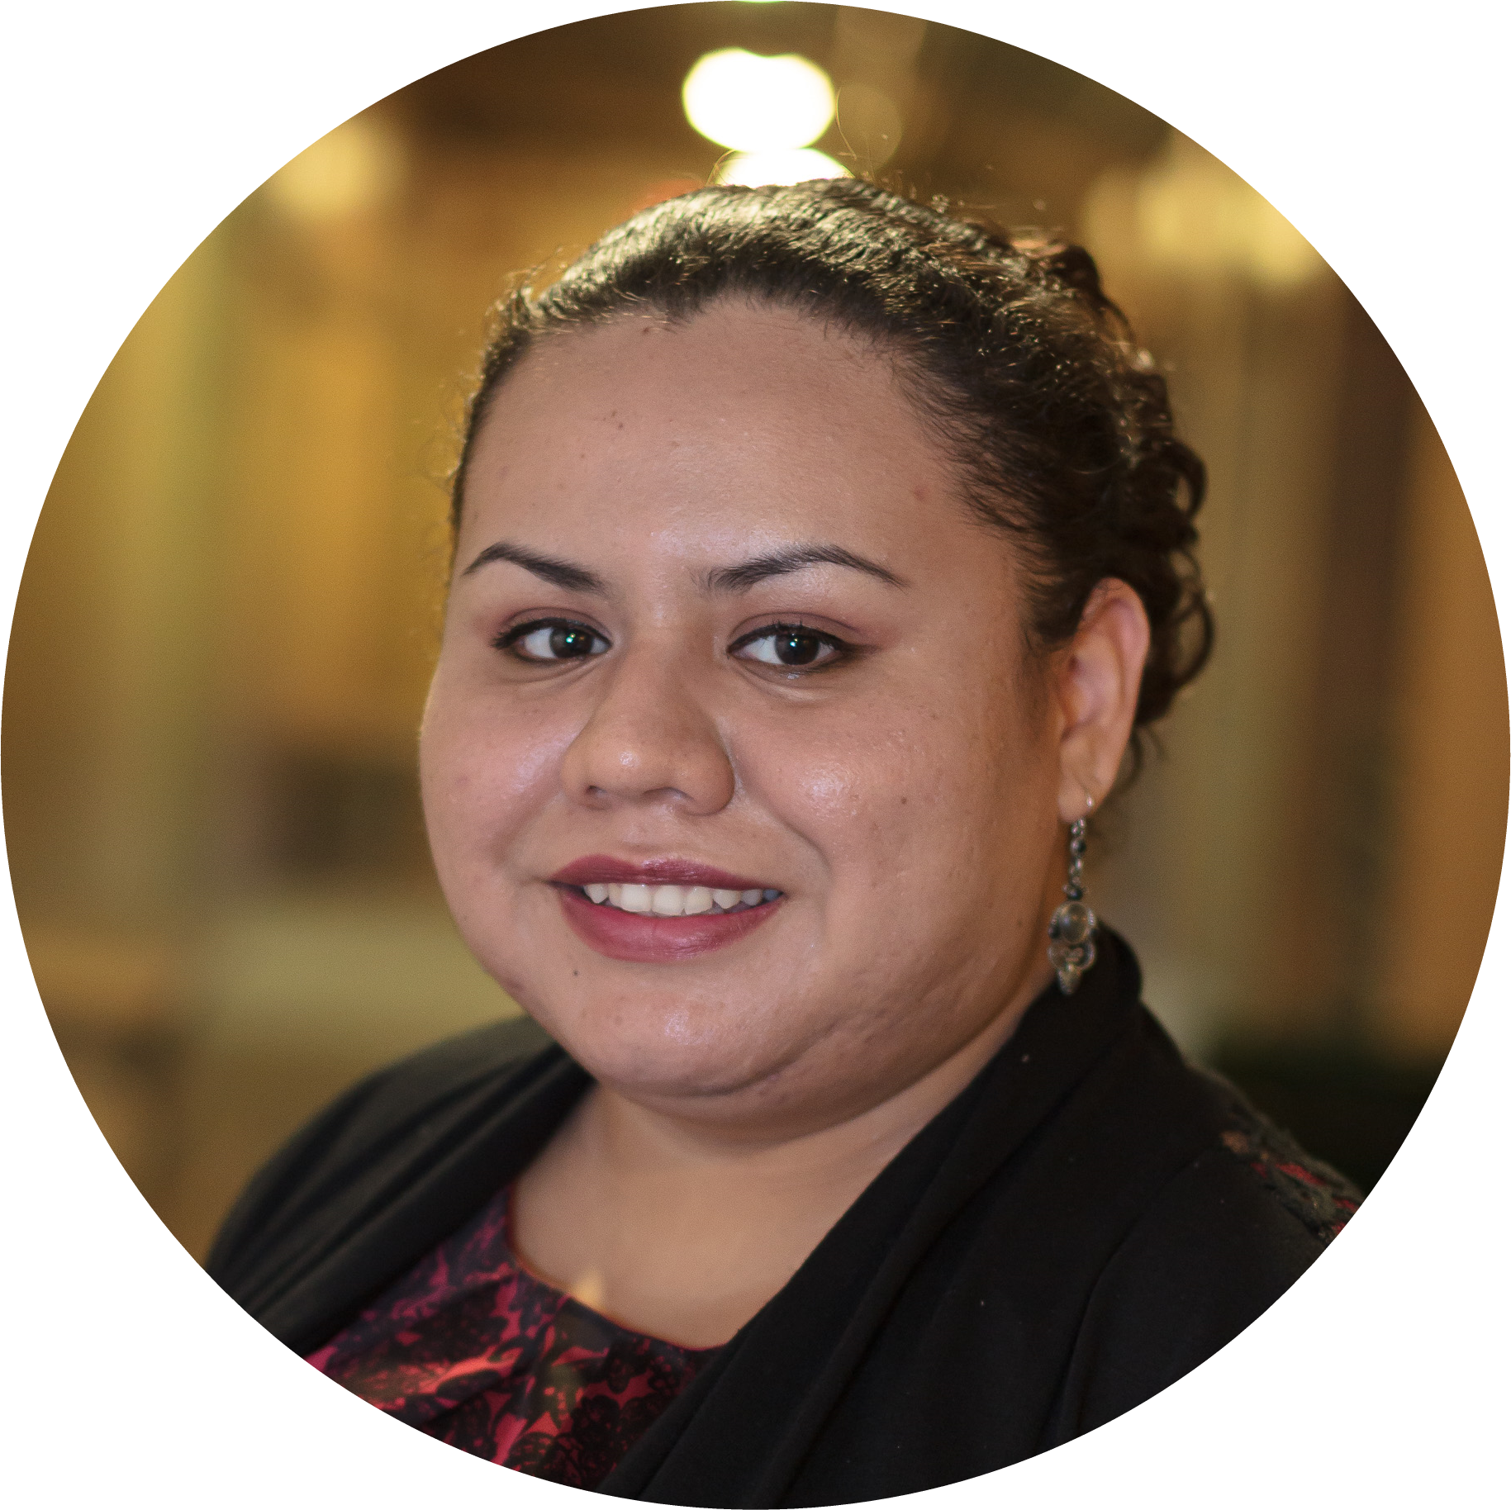
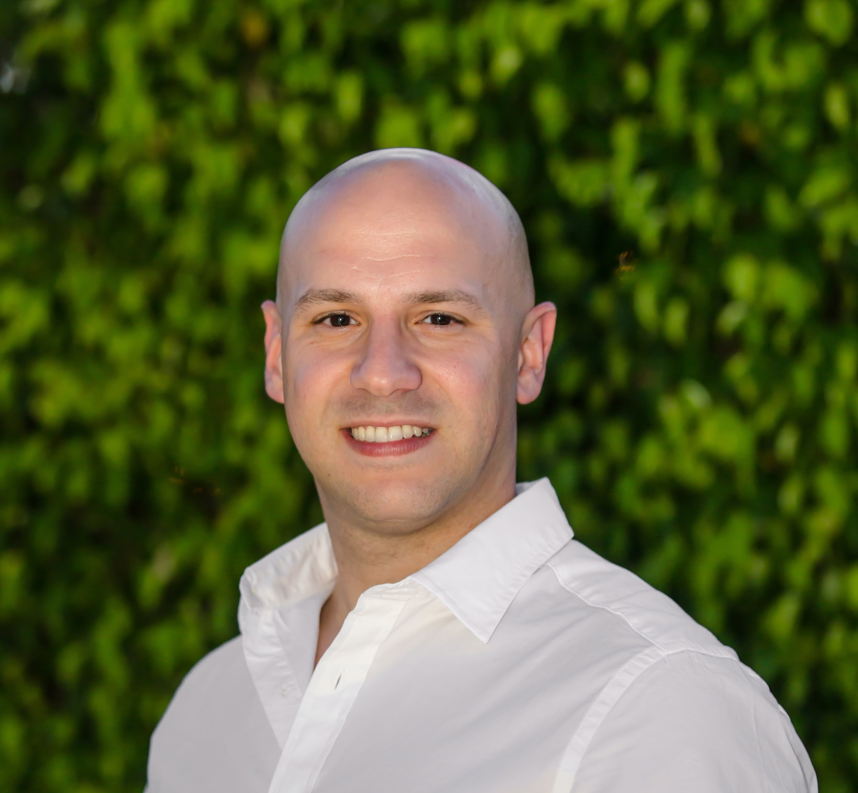
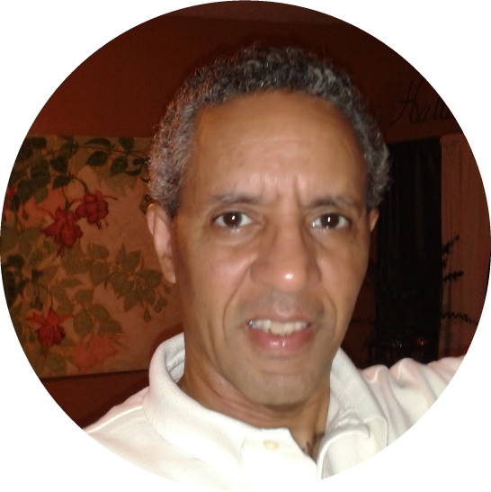
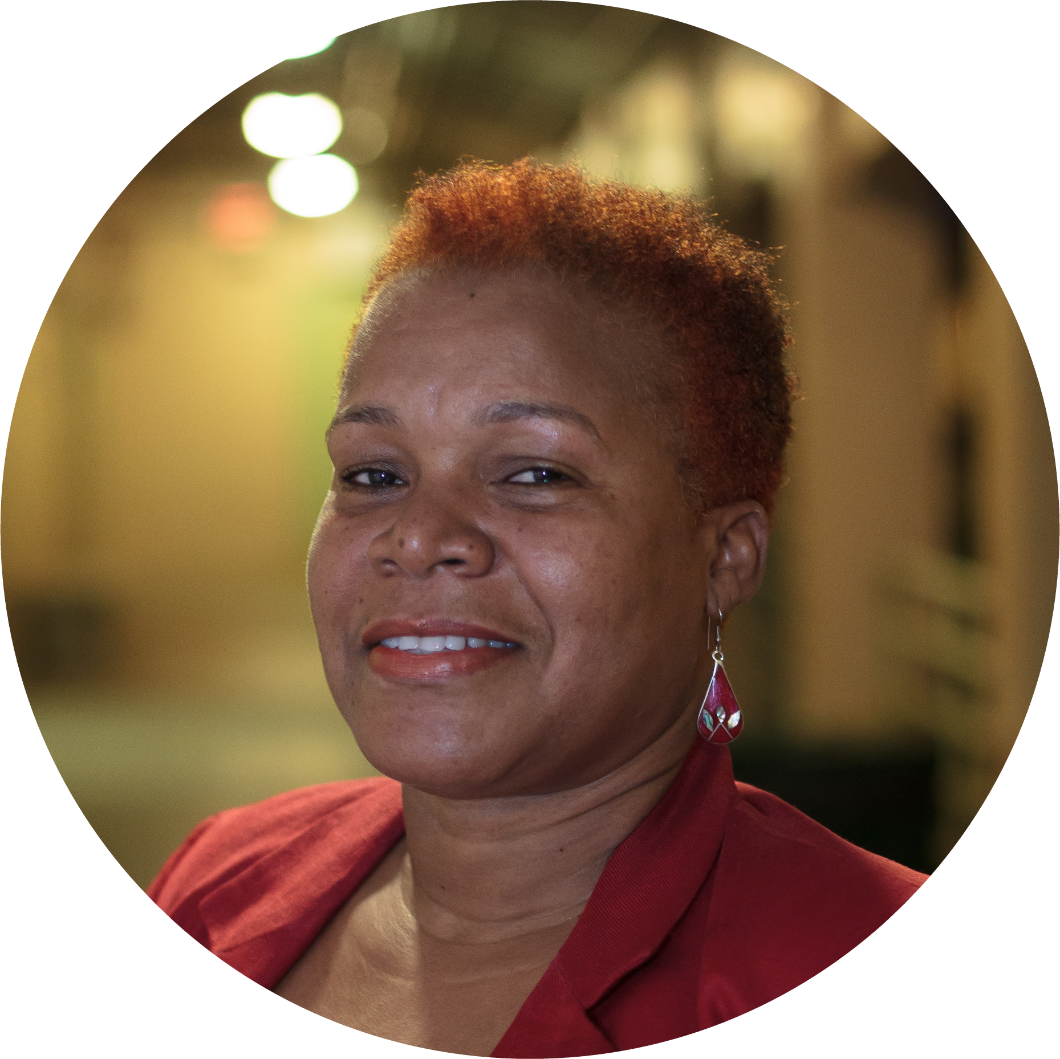
The Team
This is our team of exceptional people.
Mevurah Deleon
Content Writer Specialist
Joey Diaz
Project Manager
Jorge Garcia
Graphic Designer
Carol A. Mitchell-James Quality Assurance Specialist

Slide 3
Agenda
To establish a web presence
To provide contact details to potential customers
To make available product information & pricing to customers
To gain a favorable impression of the company

Slide 4
The Process
We follow Agile Project Management procedures, focussing on continuous improvement, scope flexibility, team input and the delivery of essential quality products
Plan
Choose software tools needed
Gather required information
Select a work methodology
Establish an effective communication system
Identify project Scope
Assign roles
Organize
Determine duration of the project: 32 Days
Number of Sprints: 4
Days per Sprint: 8 Days
Build
Build website using GoDaddy, a publicly traded Internet domain registrar and web hosting company
Deploy
Test prototypes
Ensure product quality

Slide 5







Digital in the USA
322.9 million people
282.1 million people
Active Internet Users
87%
192.0 million people
Active Social Media Users
68%
169.0 million people
Active Mobile Social Users
88%
Data retrieved from www.smartinsights.com

Slide 6




Top Active Social Platforms
41%
17%
15%
12%
Data retrieved from www.smartinsights.com

Slide 7












What they currently have
Social Media
Web Presence
NO reviews in Yelp
NON Existent
27 pictures
NO reviews in Facebook
75 likes
12 visits
94 followers in Instagram
218 following 11 posts
NO tweets in Twitter
NO results in Google+

Slide 8

Our Milestones
We start small but think
BIG
Milestone# 1 Facebook
Milestone# 2
Yelp
Milestone# 3
Twitter
Milestone# 4
Instagram
Milestone#5
Google+
100 likes
20 visits
10 Tweets
5 Reviews
100 followers
10 followers
5 five-star reviews

Slide 9
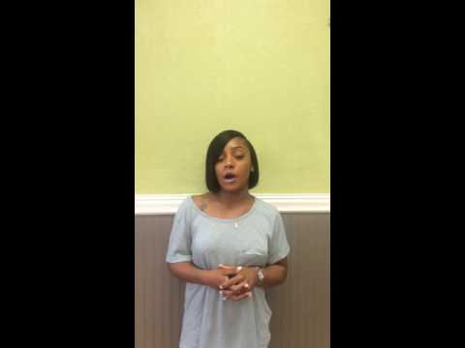
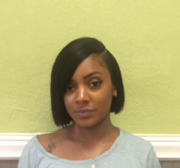
Testimonial From The Manager
We’ve been around for a little more than a year now but we are having trouble with customer exposure. I am very thankful, very excited, we can work together and get something started.
A’Bionca Bell
Manager Tight Work Soul & Seafood Grill

Slide 10

Logo Redesign
Misleading oriental logo design
Non-oriental font and modified logo

Slide 11
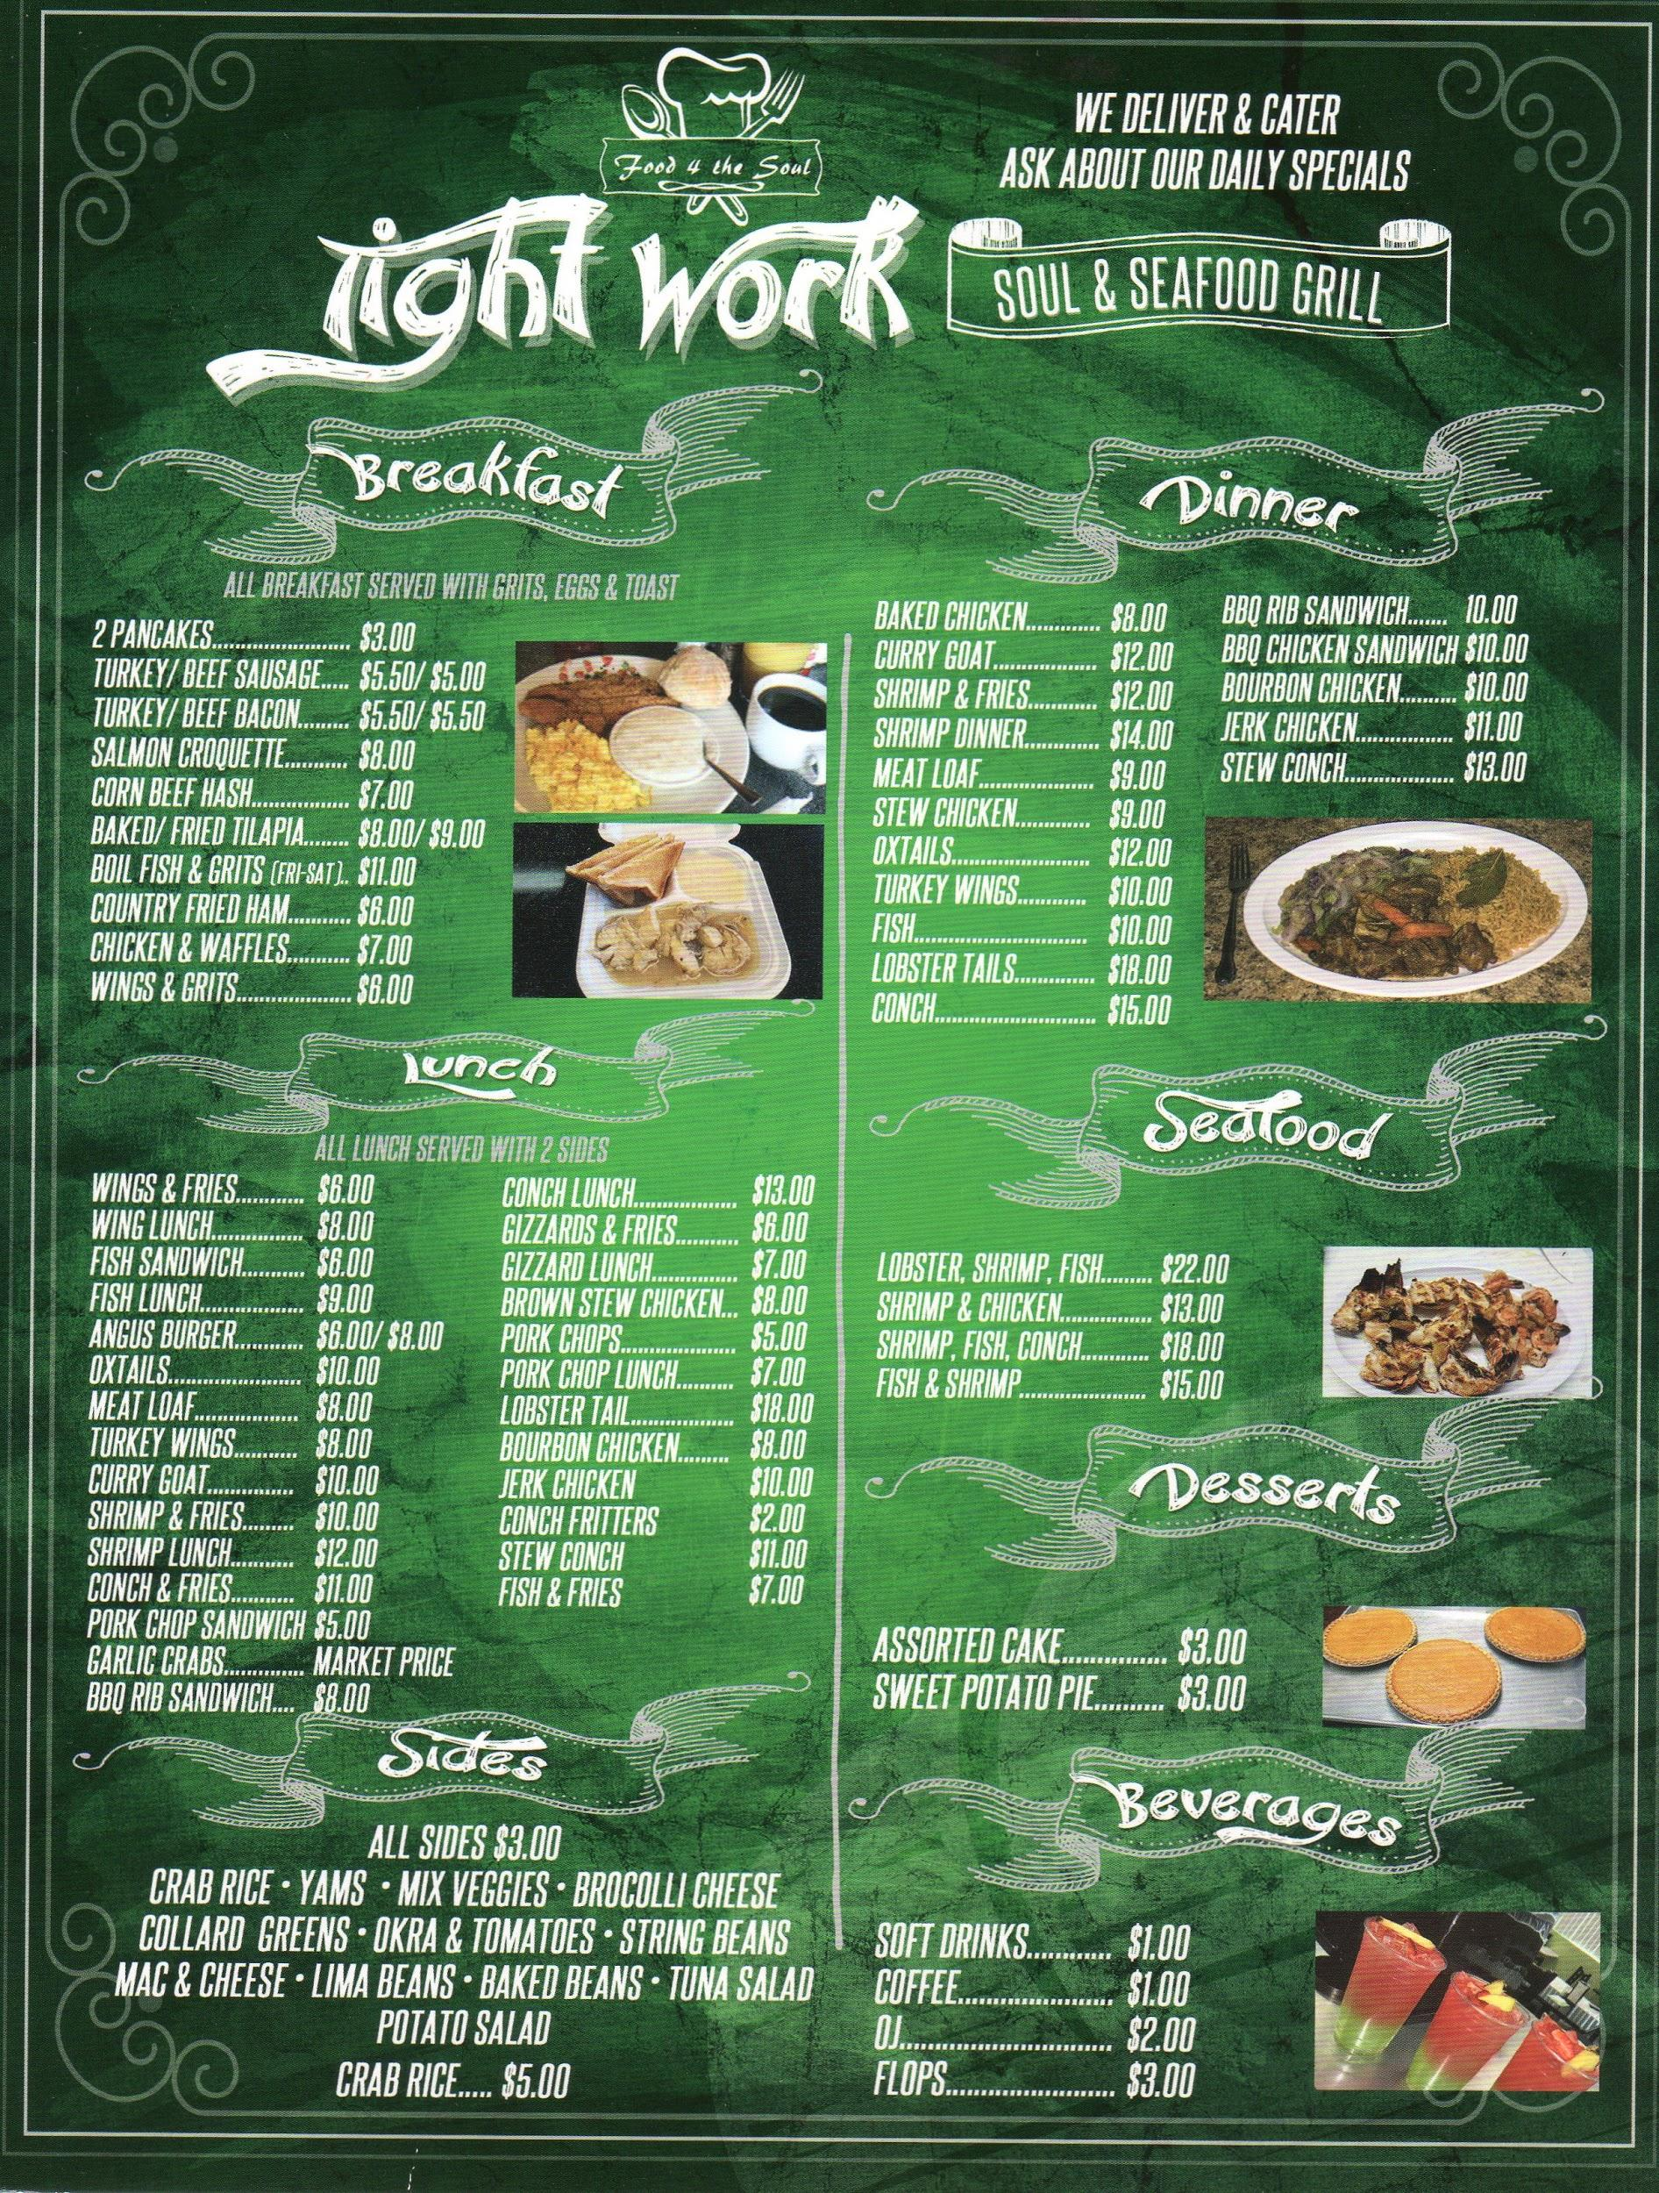
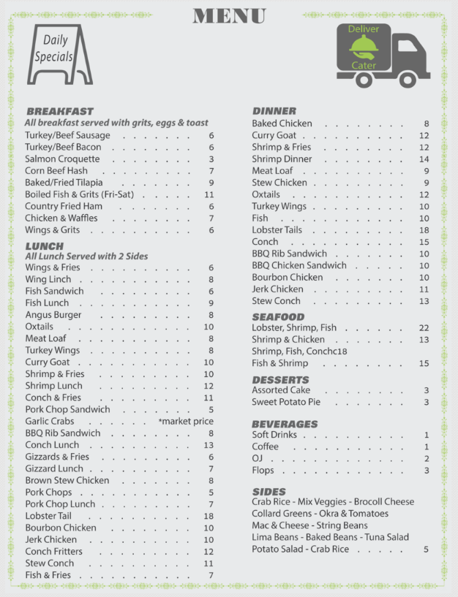

Menu Redesign
OLD MENU
NEW MENU
misaligned format
dark tone, some items have more
than one price per item
written in all capital letters
aligned format
highlighted daily specials,
delivery and catering services
simplified price format

Slide 12
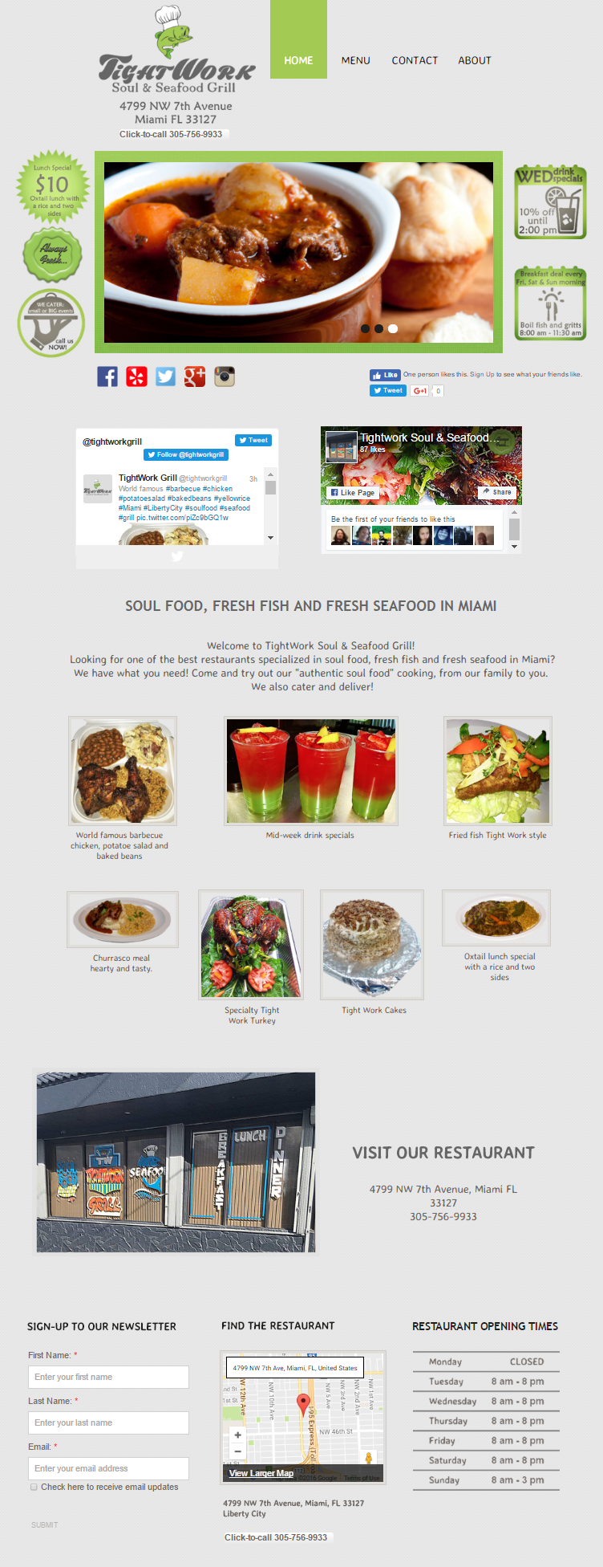
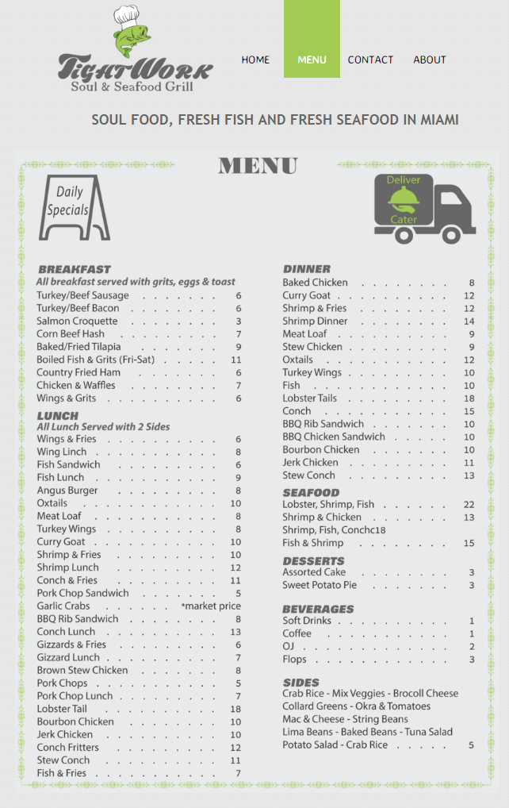
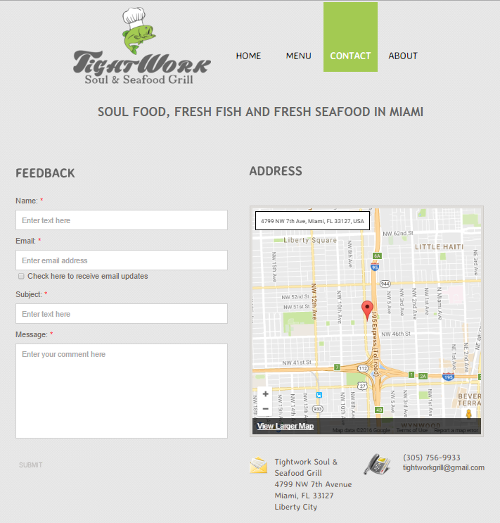
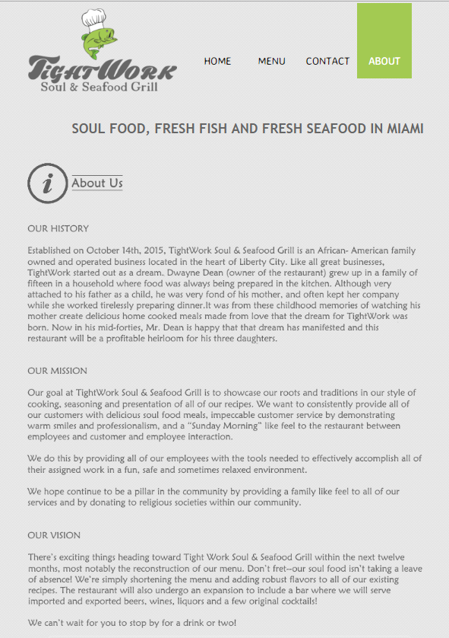
HOME
MENU
CONTACT
ABOUT
DESKTOP VIEW

Slide 13
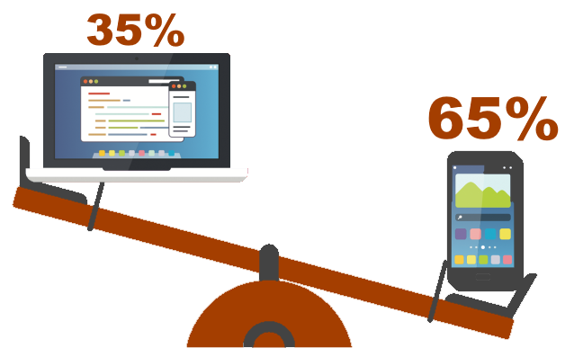


Desktop VS Mobile
Mobile Users
65%
Our website has been tested
in the following devices: Samsung Galaxy Tablet E
Samsung Galaxy S7 Cell Phone
Iphone 5S Cell Phone
Iphone 6 Cell Phone
13” Macbook Pro Laptop
15” Toshiba Laptop
Responsiveness test: passed
Data retrieved from www.marketingland.com

Slide 14
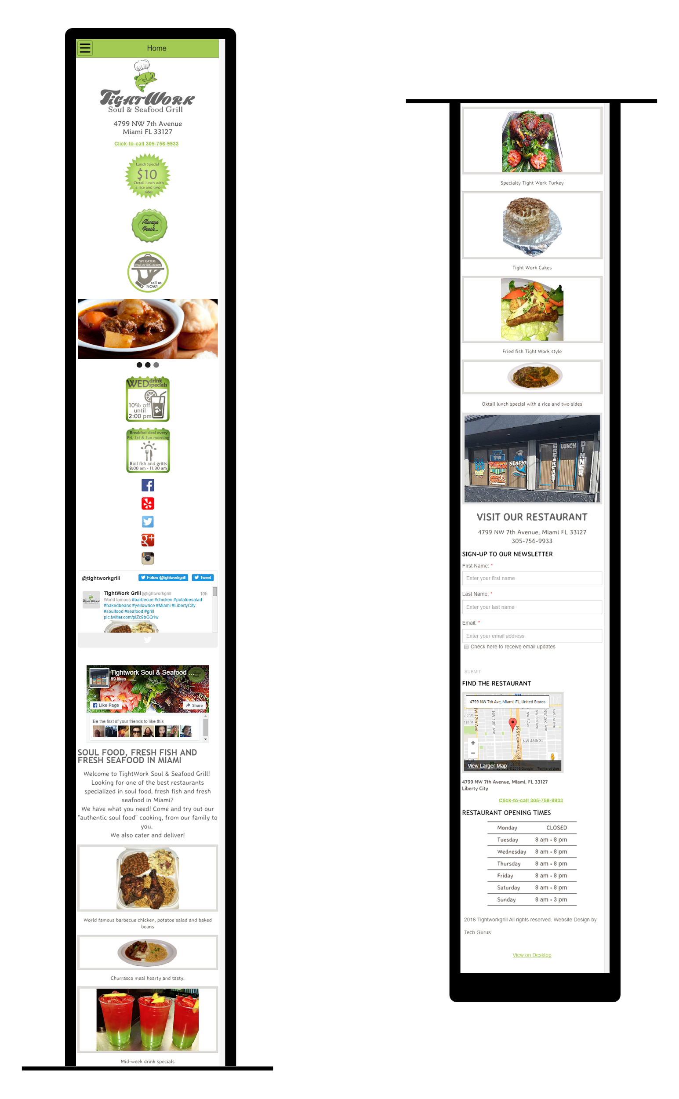
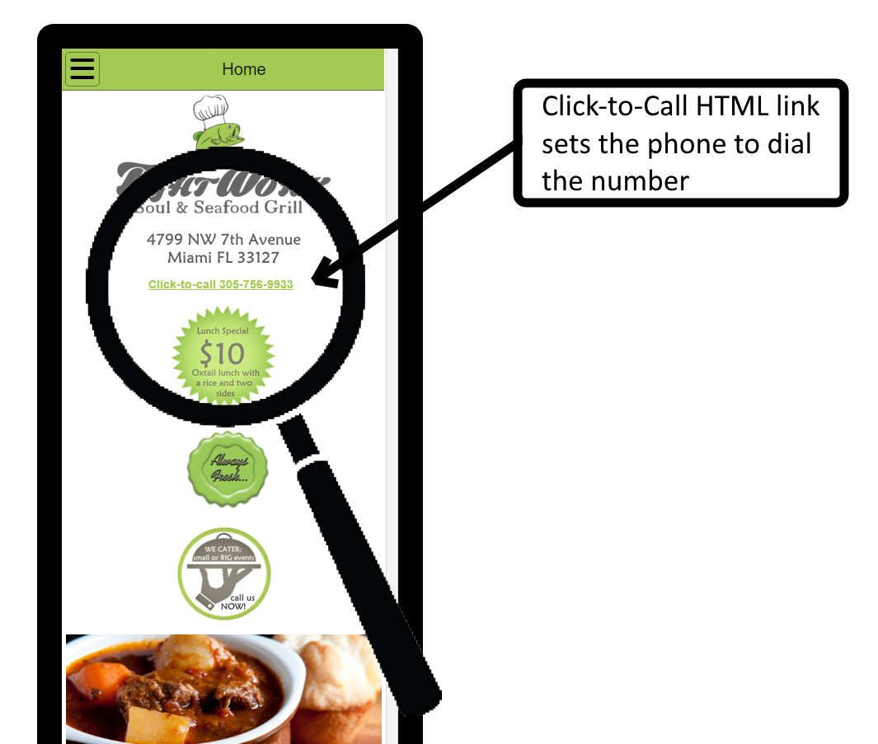
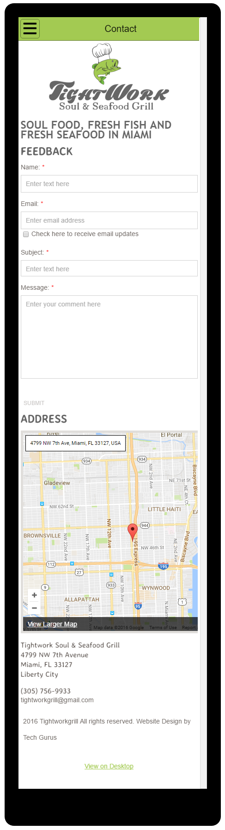
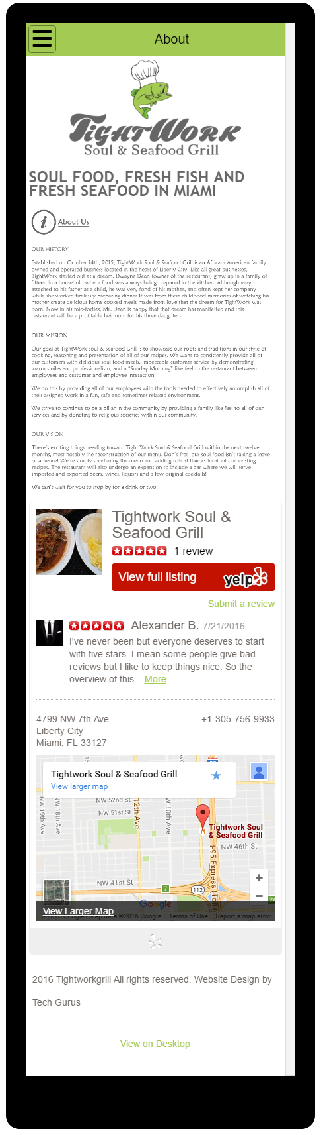
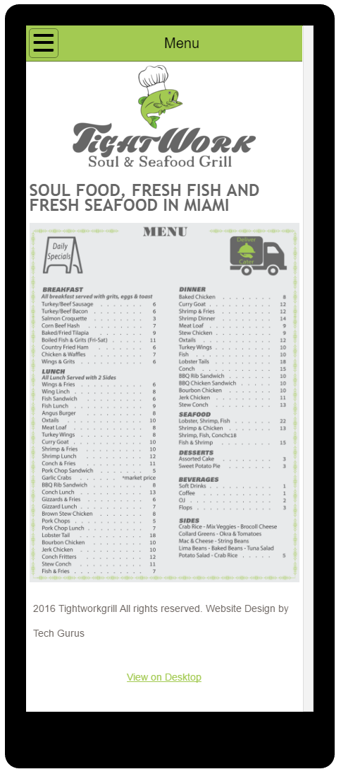
Mobile Views Demonstration
HOME
(mobile)
HOME
(mobile)
MENU
(mobile)
CONTACT
(mobile)
ABOUT
(mobile)

Slide 15
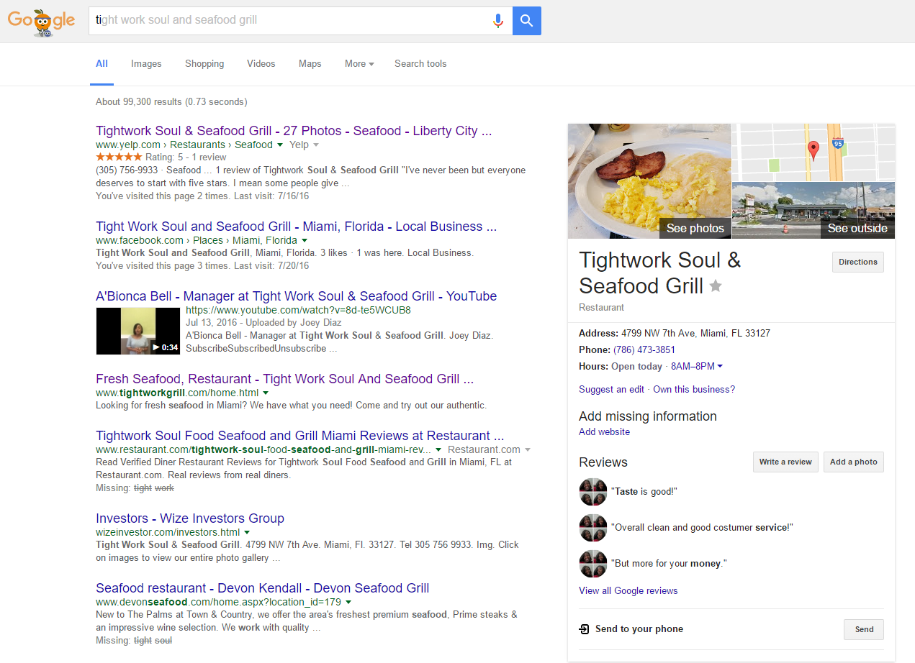

SEO (Search Engine Optimization)
We also took care of the back end

Slide 16




CTA (Call to Action)
Promoting the restaurant’s best lunch special
Announcing the restaurant’s specialty breakfast
Triggering a call to provide catering services
Attempting to bring more customer traffic in the restaurant

Slide 17
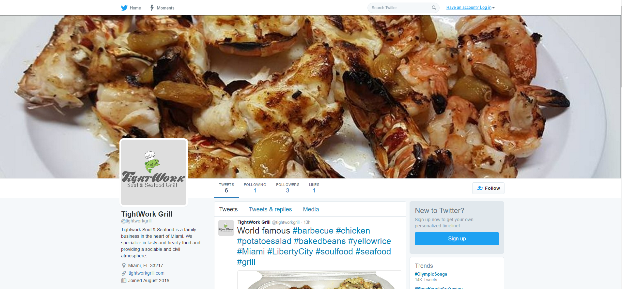



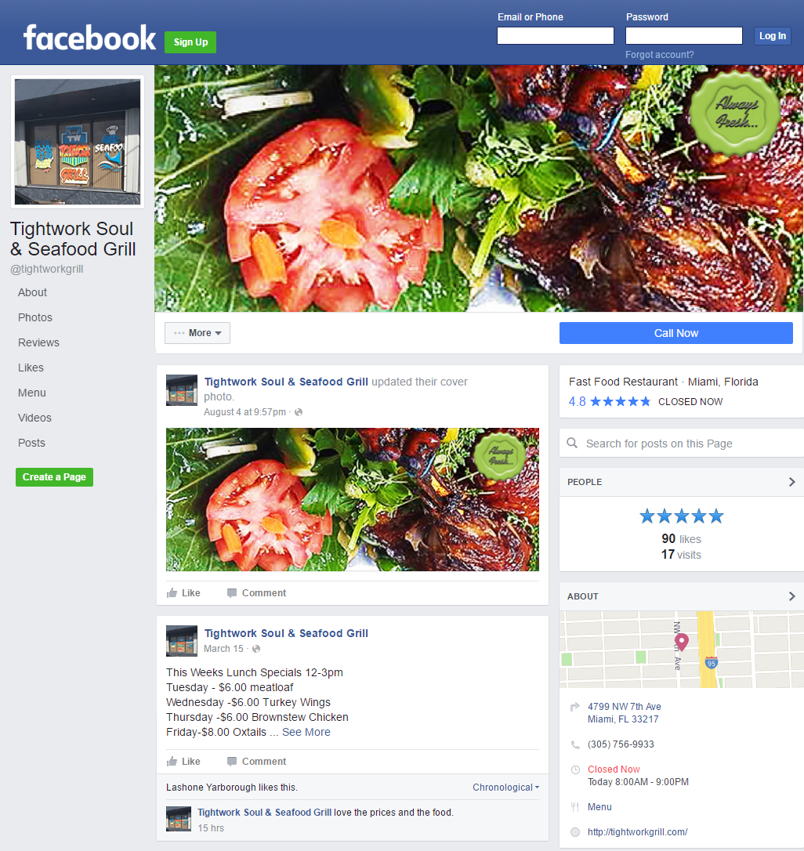
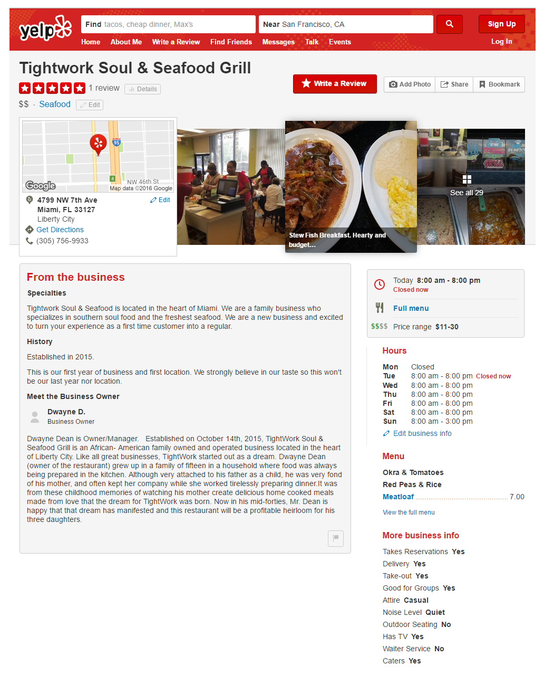
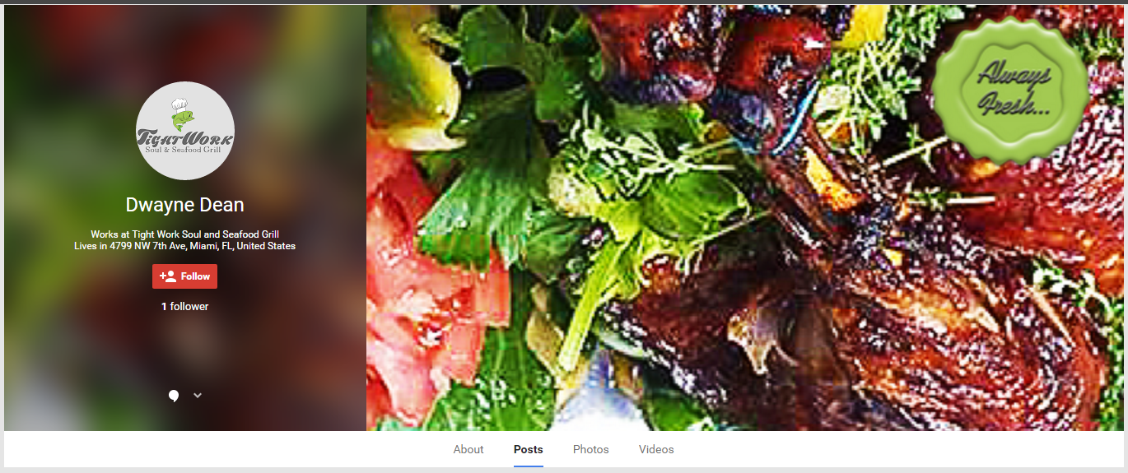

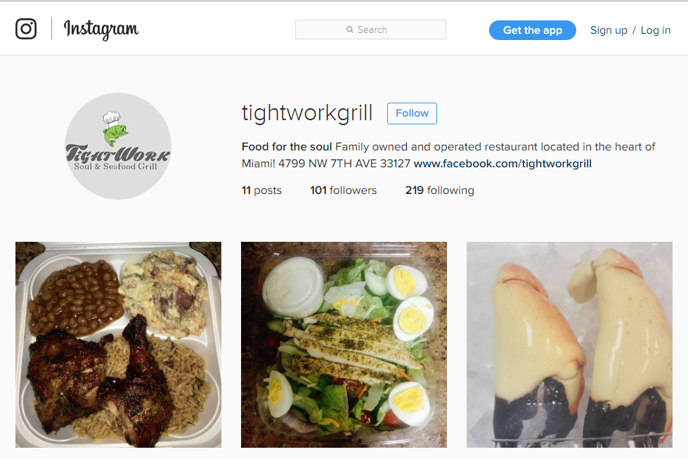

The importance of social media

Slide 18
Thank You !
for your time and attention
www.tightworkgrill.com
Website design by Tech Gurus

